Slide 1
EXECUTIVE REPORT | SURVIVAL ANALYSIS
Executive Summary
1,470
Employees analyzed
16.1%
Historical attrition rate
1,233
Active & scored for risk
0.846
Test concordance index
MODEL VALIDATION
HEADLINE FINDINGS
Concordance 0.849 train / 0.846 test -- consistent, no overfitting.
Final model refit on all 1,470 employees after validation.
Proportional-hazards assumption checked per covariate before trusting hazard ratios.
Strongest driver: Over Time (Yes) -- hazard x2.20.
Top at-risk employee: ID 2021 -- 25% predicted chance of leaving within a year.
Top 15 at-risk employees identified for targeted retention outreach.
Cox Proportional Hazards Model | Headcount Attrition Analysis
01

Slide 2
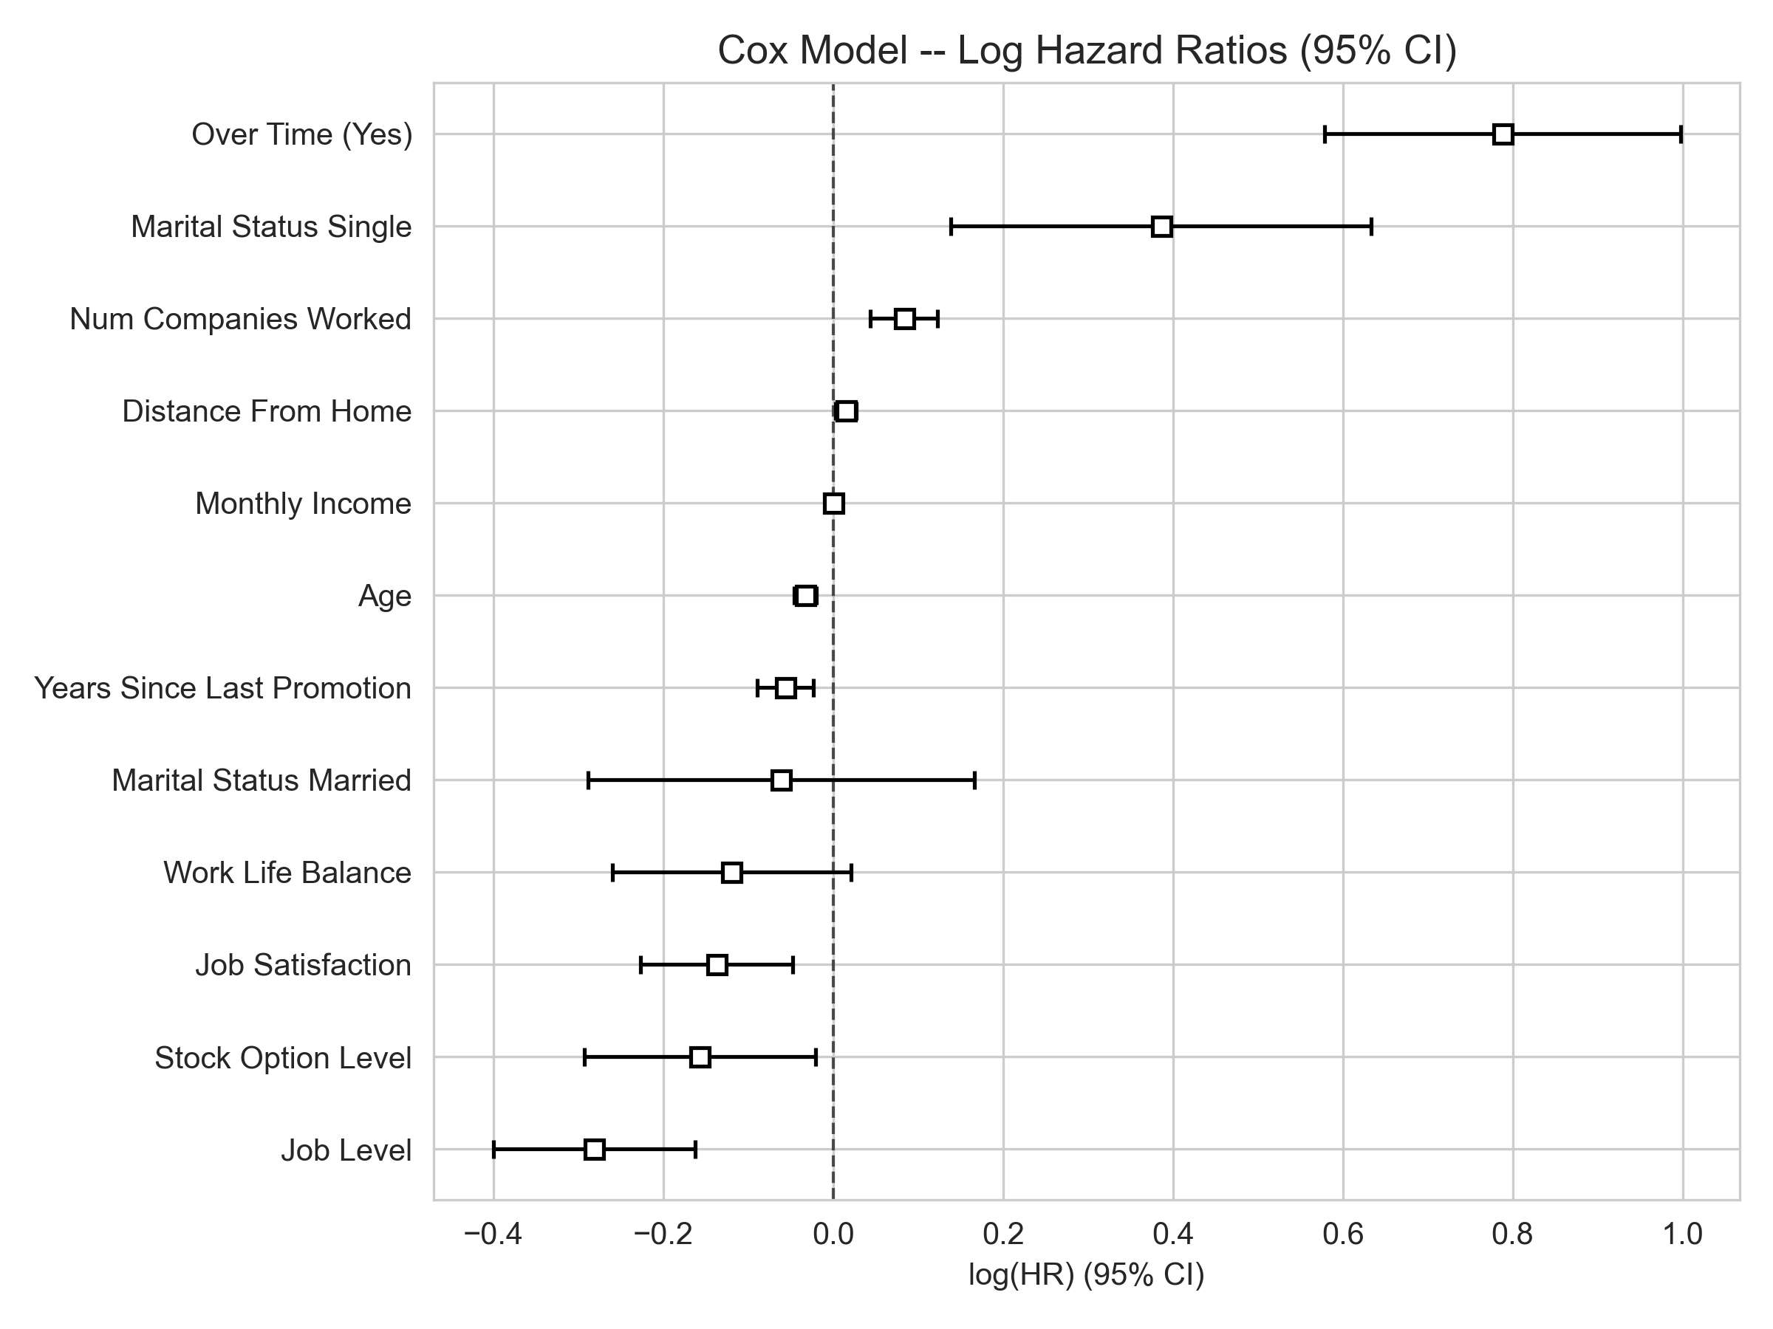
EXECUTIVE REPORT | SURVIVAL ANALYSIS
What Drives Attrition
COEFFICIENT PLOT
HAZARD RATIOS
Over Time (Yes)
x2.20 hazard · p = 0.000
Age
x0.97 hazard · p = 0.000
Job Level
x0.75 hazard · p = 0.000
Num Companies Worked
x1.09 hazard · p = 0.000
Monthly Income
x1.00 hazard · p = 0.000
Years Since Last Promotion
x0.95 hazard · p = 0.001
Hazard ratio above 1.0 raises resignation risk; below 1.0 lowers it. Forest plot shows 95% confidence intervals.
Cox Proportional Hazards Model | Headcount Attrition Analysis
02

Slide 3
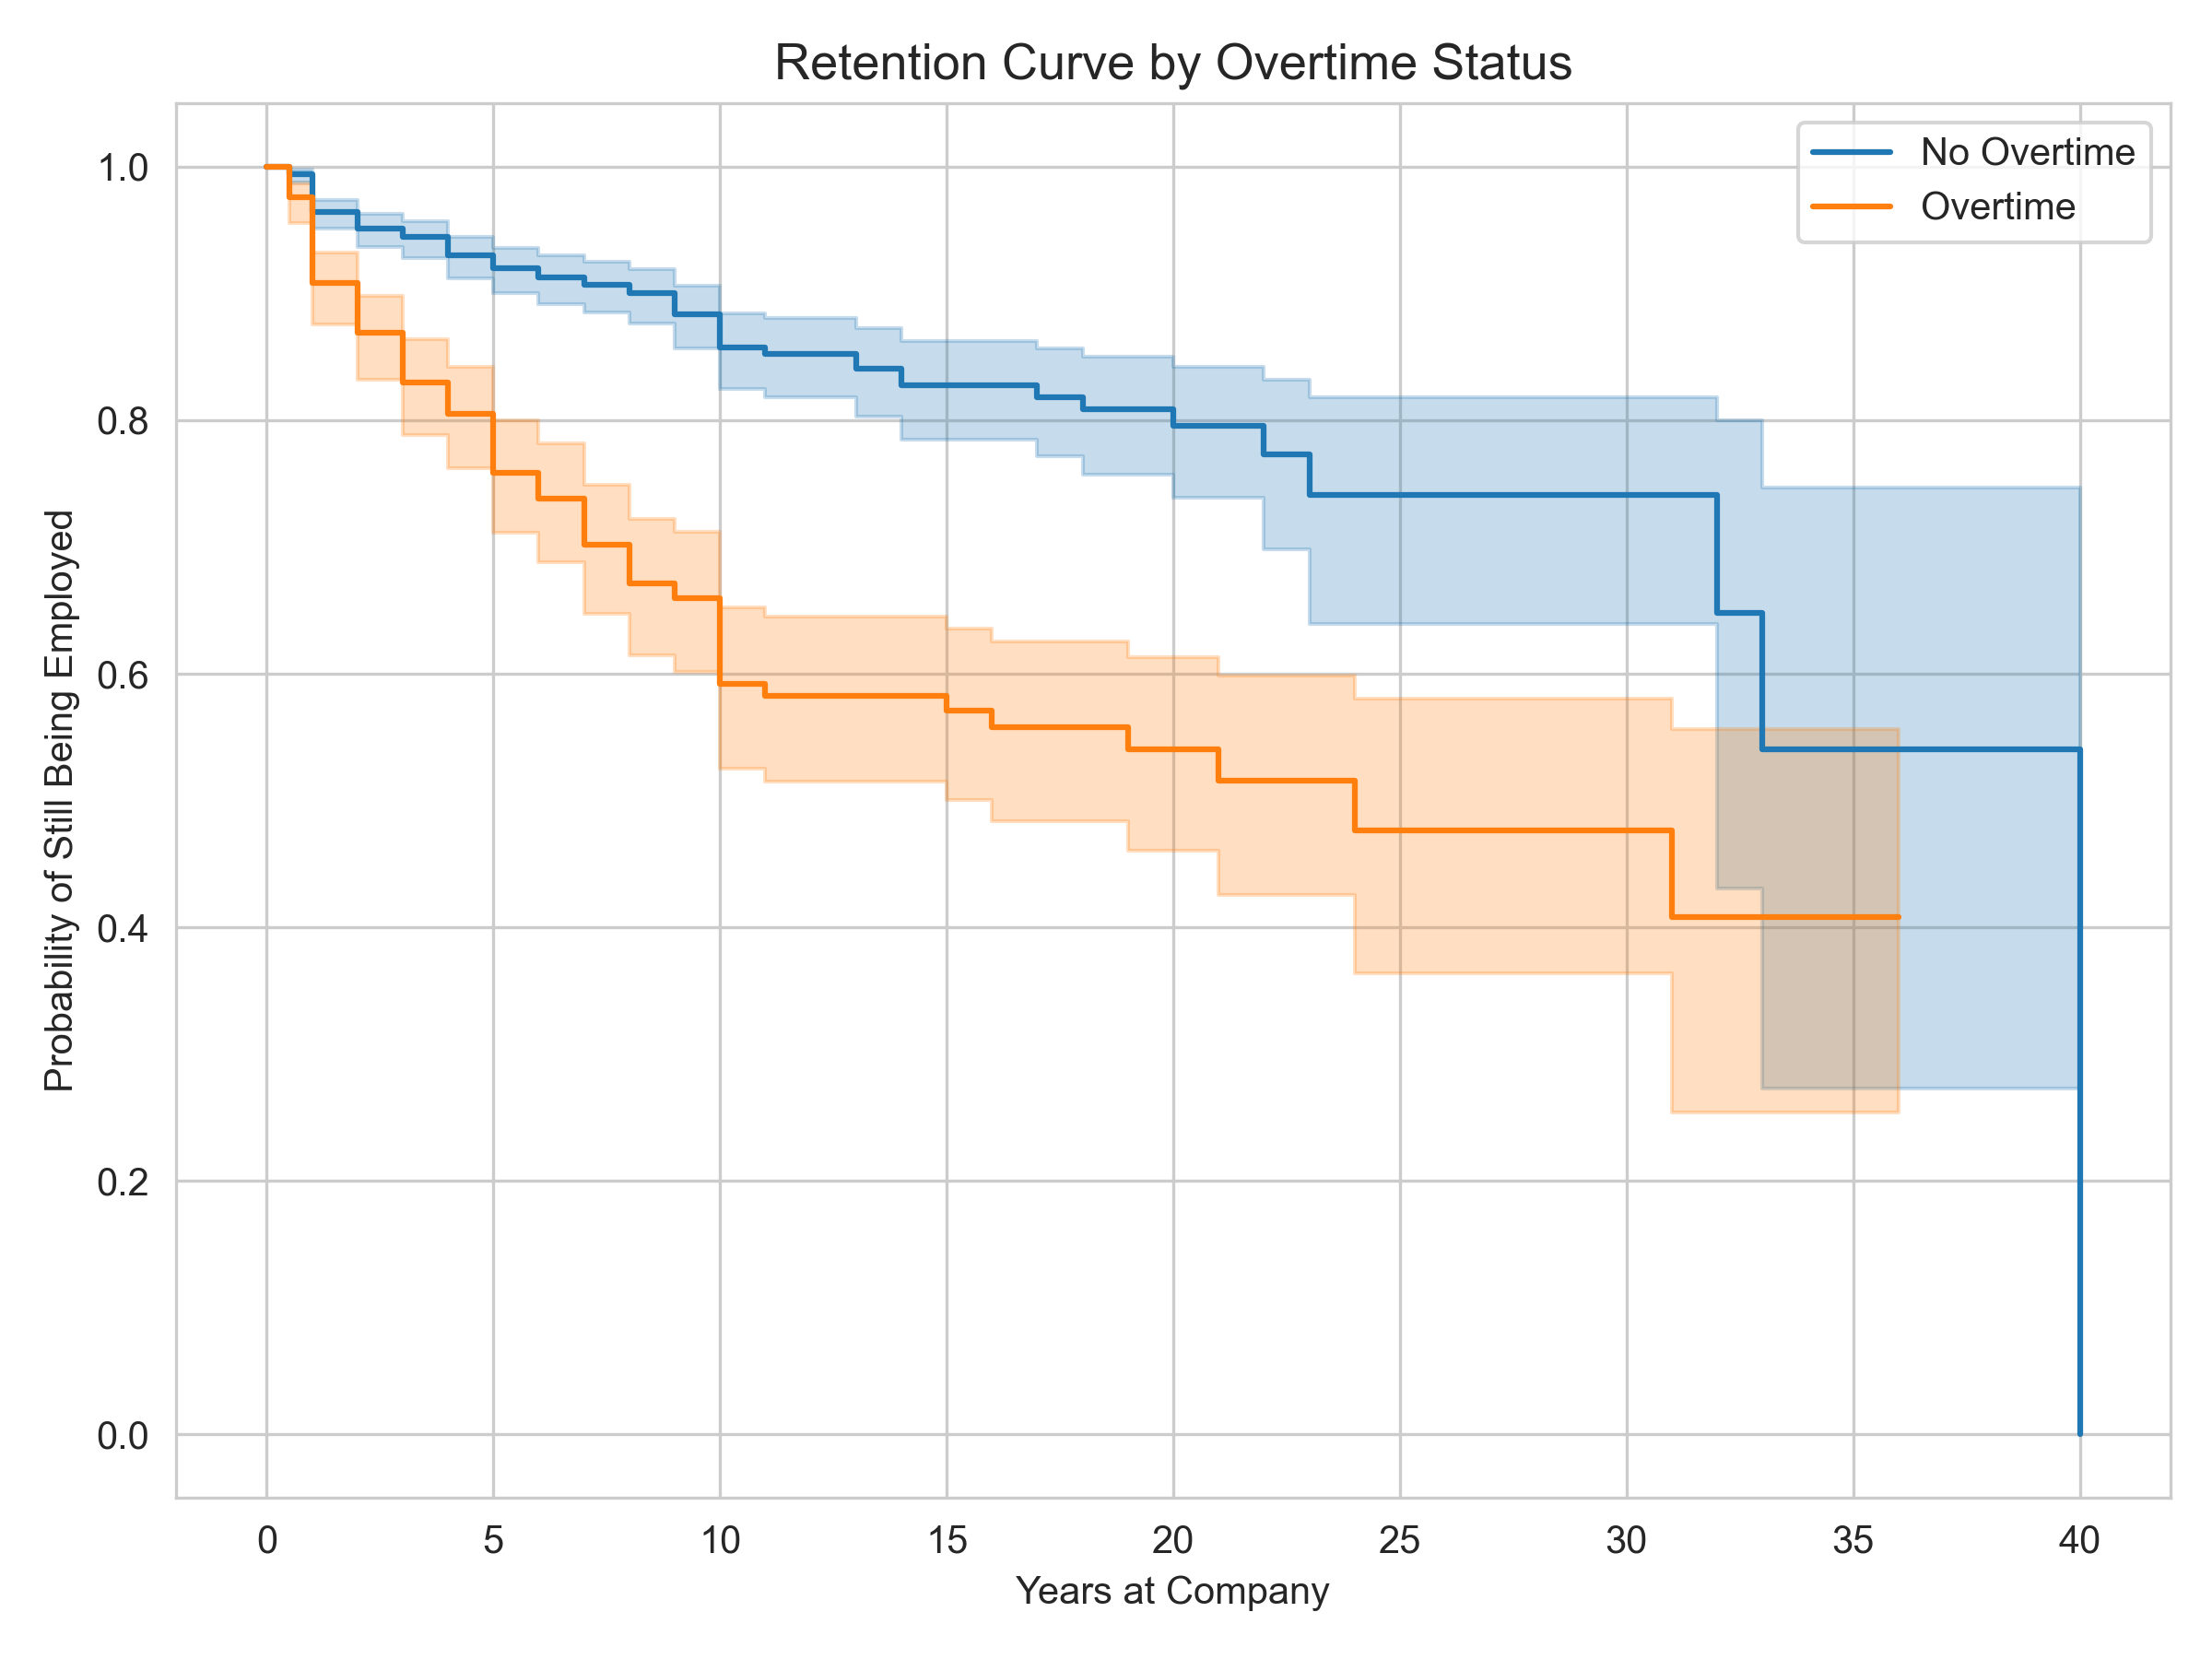
EXECUTIVE REPORT | SURVIVAL ANALYSIS
Retention by Overtime Status
KAPLAN-MEIER SURVIVAL CURVES
SIGNIFICANCE TEST
p = 1.6e-19
Log-rank test -- the retention gap between overtime and non-overtime employees is statistically significant.
SO WHAT
Overtime is the single most directly actionable factor found.
Curves show the share of employees still employed over time, split by overtime status.
Cox Proportional Hazards Model | Headcount Attrition Analysis
03

Slide 4
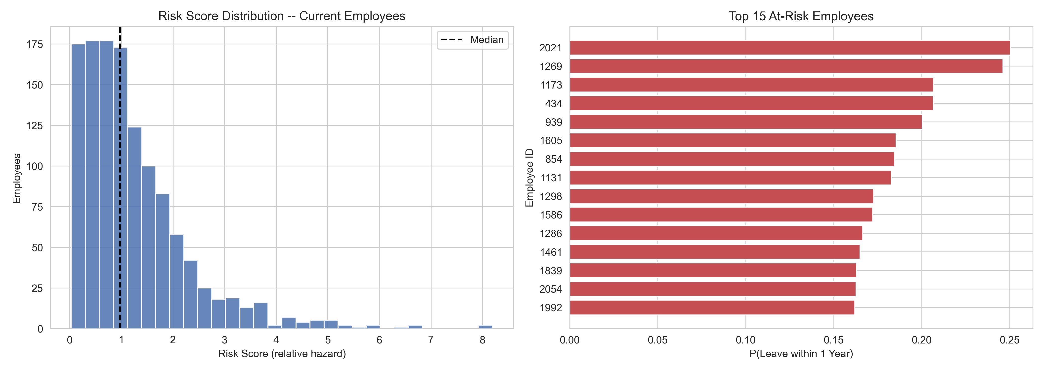
EXECUTIVE REPORT | SURVIVAL ANALYSIS
Who Is at Risk Right Now
TOP 15 EMPLOYEES BY 1-YEAR LEAVE PROBABILITY
1,233
Current employees scored
8.19
Highest risk score vs. median 0.98
NEXT STEP
Open retention conversations with the 15 employees shown above.
Cox Proportional Hazards Model | Headcount Attrition Analysis
04

Slide 5
EXECUTIVE REPORT | SURVIVAL ANALYSIS
Recommendations
PRIORITY ACTION
Prioritize retention conversations with the top 15 employees flagged in this report.
KEY HAZARD DRIVERS
RISK
Over Time (Yes)
Raises hazard by 120%.
RISK
Marital Status Single
Raises hazard by 47%.
PROTECTIVE
Job Level
Lowers hazard by 25% per unit increase.
PROTECTIVE
Stock Option Level
Lowers hazard by 15% per unit increase.
Cox Proportional Hazards Model | Headcount Attrition Analysis
05

